Slide 1
An Observational, Non-Interventional, Multi-Center, Multi-National Study of Patients with Atypical Hemolytic-Uremic Syndrome

Slide 2
Study Overview
The aHUS Registry is an observational, non-interventional, multinational study to collect important data on the progression of an ultra-rare disease, aHUS, regardless of therapy.
The aHUS Registry has been developed in order to describe the real-world outcomes of aHUS, collecting data on a wide range of patients from all over the world
Inclusion
Exclusion
Male or female patients of any age, including minors, diagnosed with aHUS
Able to give written informed consent (Patient or parent/guardian)
HUS only due to STEC
Unable to given written informed consent

Slide 3
aHUS registry objectives
To establish a robust, global database of patients with aHUS
To characterize the clinical course of patients with aHUS
Including long-term consequences of TMA complications/manifestations, other morbidities, and mortality
To enhance the understanding of aHUS by publishing analyses of Registry data

Slide 4
Benefits to the patient
Personal contribution of data that can be used to help improve the medical understanding, knowledge and management of aHUS
Data collected can provide benefits to other patients with aHUS
Participating patients have the potential for ready access to new information about aHUS that may be of interest to them or their families
Information about Registry study and aHUS
Evaluating options for distributing updates to patients; e.g., patient newsletters
General information may be published on Registry website

Slide 5
Physician benefits
Contribute to one global, longitudinal database of patients with aHUS
Collaborate with other physicians from around the globe dedicated to aHUS
Access data and receive regular feedback with Registry updates and findings
Increase knowledge about treatment outcomes in patients with aHUS

Slide 6
Patient & physician participation
All Physicians managing patients with aHUS are eligible to participate
All patients of any age diagnosed with aHUS, regardless of treatment;
Diagnosis defined by:
Clinical diagnosis of aHUS
Patients with or without an identified complement regulatory factor genetic mutation or anti-complement factor antibody
ADAMTS13 >5% (if performed)
Exclusion criteria: patients with Hemolytic Uremic Syndrome (HUS) only due to Shiga Toxin

Slide 7
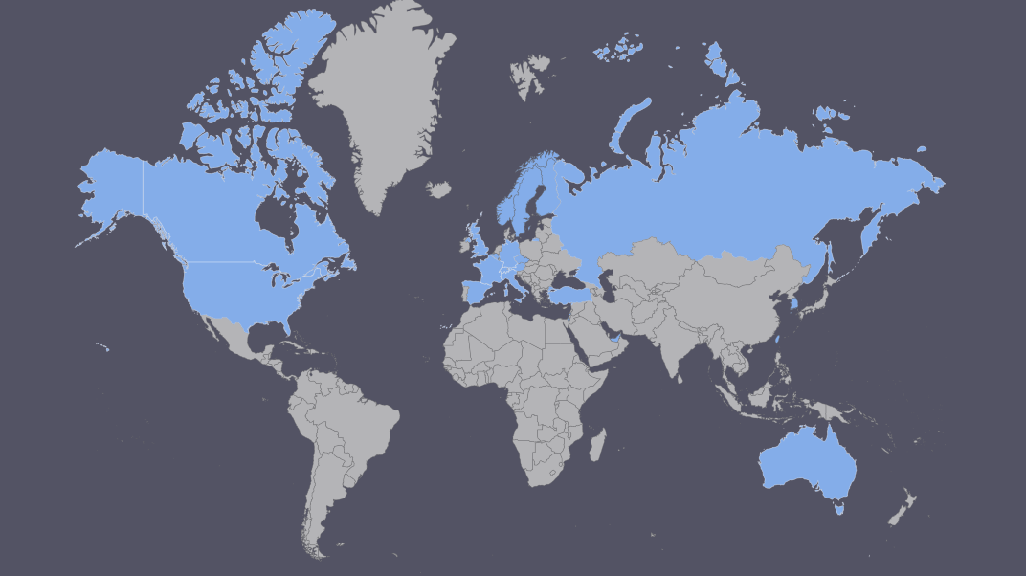
Global presence
The Goal is for the aHUS Registry to become the largest, most comprehensive database on aHUS
First patient enrolled in April 2012
As of April 2022
Over 300 sites across 23 countries have been initiated
~ 2000 patients enrolled

Slide 8
Data collection (physician)
Physician-Reported Data
Data will be collected at study enrollment and every 6 months thereafter for all patients in the study
Data entry includes information on demographics, medical and disease history, TMA manifestations, aHUS diagnosis, symptomology, clinical outcomes, concomitant medications, and safety. Pregnancy and lactation data will also be collected (if applicable)
All necessary information will be gathered from patient medical records and will be entered via a secure web portal and maintained anonymously

Slide 9
Data collection (patient)
Patient Reported Outcomes
Patients complete questionnaires at study enrollment and every six months thereafter
Patient Reported Outcomes (PROs) include:
Patient Reported aHUS Symptoms
Patient Questionnaire
Resource Utilization
General Health
Work Status
FACIT-Fatigue
EQ-5D-5L
PedsQL
TSQM-9

Slide 10
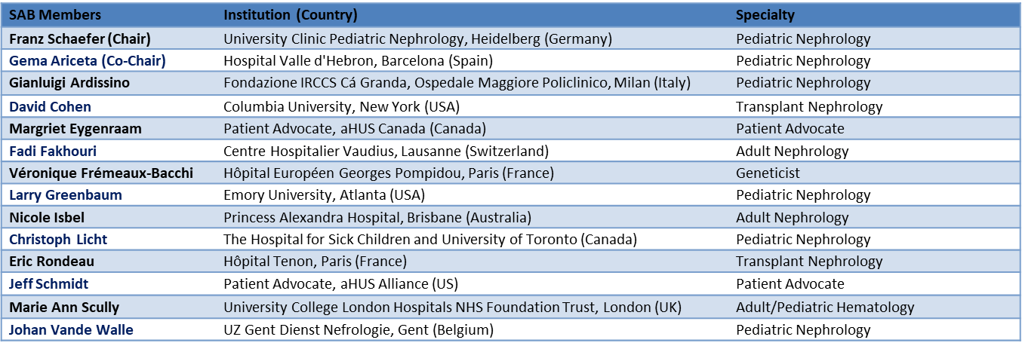
Registry governance
Scientific advisory board
Membership as of April 2022

Slide 11
Registry strengths and value
Global nature of the aHUS Registry will enable ability to describe global trends and/or differences across regions
Longevity of the aHUS Registry will allow for true understanding of long-term outcomes of disease and treatment
Creation of one global database will eventually yield a denominator large enough for complex longitudinal and statistical analyses

Slide 12
Contact details
If you would like more information, please contact the aHUS Registry Support Team
Email: aHUS-Registry@SyneosHealth.com

